Slide 1



Department of Computer Science and Engineering
OBSTACLE DETECTION USING AI
BIYYAPU VAISHMITHA REDDY - 211419104043
DHANVARSHINI.R - 211419104
DIVYA.N - 211419104
MRS.K.SANGEETHA M.E, & ASSISTANT PROFESSOR
DR. L.JABASHEELA M.E,Ph.D.,& HOD

Slide 2
Introduction
Over the years we have witnessed the success of convolution neural network (CNN) for visual obstacle detection. To represent obstacle of various appearance, poses with limited convolutional features, many CNN-based detectors leverage anchor boxes as reference points for image localization. By assigning each obstacle to video at proper scales and aspect ratios, convolutional features are determined and two fundamental detection procedures, classification and localization, are carried out. Obstacle-based detectors leverage spatial alignment, i.e., Intersection over Union (IoU) between object and obstacle, as the criterion for anchor assignment. Each assigned anchor independently supervises network learning for obstacle prediction, based upon the assumption that the anchors spatially aligned with obstacle are always appropriate for classification and localization. In what follows, however, we argue that such an assumption is implausible and the spatial alignment should not be the sole criterion for anchor assignment. On the one hand, for obstacle of acentric features, e.g., slender objects, the most representative features are not close to their geometric centers.

Slide 3
Objective of the Project
In this study, we propose a learning-to-match (LTM) method to break IoU restriction, allowing objects to match anchors in a flexible manner. LTM updates hand-crafted anchor assignment to “free” anchor matching by formulating detector training in the Maximum Likelihood Estimation (MLE) framework. During the training phase, LTM is implemented by converting the detection likelihood to anchor matching loss functions which are plug-and-play. Minimizing the matching loss functions drives learning and selecting features which best explain a class of objects with respect to both classification and localization. LTM is extended from anchor-based detectors to anchor-free detectors, validating the general applicability of learnable object-feature matching mechanism for visual object detection.

Slide 4
Literature Survey
YEAR & AUTHOR | PAPERTITLE | METHEDOLOGY | MERITS | DEMERITS | FUTURE SCOPE
2022 &Shahira K C, Sagar Tripathy, Lijiya A | Obstacle Detection, Depth Estimation And Warning System For Visually Impaired People | Using a pre-trained neural network on COCO dataset on system. The pre-trained The pre-trained model is trained with YOLO algorithm. For complete blind individuals, we are generating audio output with the help of GTTS (Google Text-to-Speech). GTTS is a Python library to interface with Google Translate text-to-speech API. | Identify 80 classes of objects and produce auditory cues along with ranges. | Time for image de- scription is more | This can be extended to Android so that it can be used on a larger scale with interactive response delivery methods in real-time. Parallelism can be employed to optimize system utilization and improve the response time.

Slide 5
Literature Survey
YEAR &AUTHOR | PAPER TITLE | METHODOLOGY | MERITS | DEMERITS | FUTURE SCOPE
2022&Vaishali Jabade; Udit Nahata; Nipun Jain; Anvesh Pandey; Tanmay Paratk | Obstacle Detection and Walkable Path Detection | implementation of an object detection Application Programming Interface (API) using Single Shot Detector (SSD). COCO datasets and tensor flow | Can load huge data sets. | Slow loading of outputs. | Optimized algorithm can be used along with SSD to improve the accuracy.

Slide 6
Literature Survey
YEAR &AUTHOR | PAPER TITLE | METHEDOLOGY | MERITS | DEMERITS | FUTURE SCOPE
2022 & Prabou, Ashwin | Efficient Detection of obstacle objects using AI | The two models which are trained and tested in this research are the K-Nearest Neighbors and Neural Networks algorithms and models. | Reduces death of animals(accidents) | Doesn’t detect other obstacles. KNN doesn’t provide reliable outputs. | CNN and other algorithms can be used in place of KNN, for better performance.

Slide 7
Literature Survey
YEAR &AUTHOR | PAPER TITLE | METHEDOLOGY | MERITS | DEMERITS | FUTURE SCOPE
2020 & Danijela Ristić-Durrant, Muhammad Abdul Haseeb, Marten Franke, Milan Banić, Miloš Simonović & Dušan Stamenković | Artificial Intelligence for Obstacle Detection in Railways: Project SMART and Beyond | On -board sensor-based obstacle detection system. The dataset includes high-resolution grayscale and color stereo cameras, a LiDAR and fused GNSS/IMU sensor data. Convolutional Neural Network (CNN)-based models for objects BBs prediction named YOLO v3 [11] was used. | Railway time delay is reduced, less accidents | Data set training takes more time | Drone based OD can be used to find the obstacle in the rail pathway.

Slide 8
Problem Statement
To implement real - time obstacle detection and recognition in an images captured by webcam and videos in dynamic environment using deep learning model. The primary goal is to detect and recognize Obstacles in Real time. We require rich data, all things considered. We need to observe the different types of obstacles which are moving in respect to the camera. It will help us with perceiving and in recognizing different objects collaboration and interaction. We center around accuracy in this paper.

Slide 9
Proposed System
To define an anchor bag for each object and perform object-anchor matching in a maximum likelihood estimation (MLE) framework and learning-to-match method and update hand-crafted anchor assignment to learnable anchor configuration.
Camera continuously captures the images and its input frames are sent to image processing.
When the camera find there is obstacle in front of the driving vehicle, it will automatically captures the image of obstacle and send the image to process and it identifies the name of the obstacles using deep neural network, after that identification of obstacle and using AI recognized obstacle alert is given through audio signals to the driving person.

Slide 10
Software / Hardware used
S/W SYSTEM CONFIGURATION:
OPERATING SYSTEM - Windows 8/10
SCRIPT - Python
TOOL - IDLE(Python)
H/W SYSTEM CONFIGURATION:
PROCESSOR - I3, I5, I7, AMD Processor
RAM - 8 Gb
HARD DISK - Above 500 GB

Slide 11
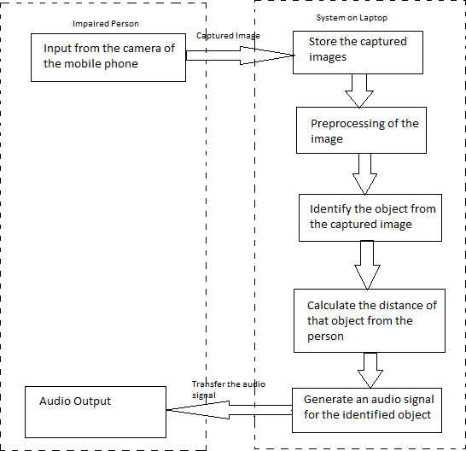
Architecture / Methodology used

Slide 12
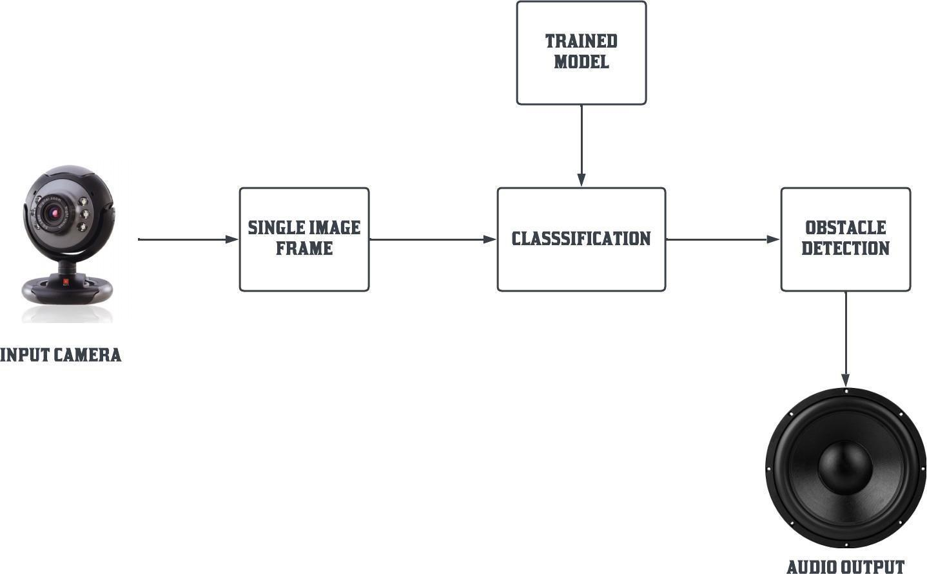
System Design - BLOCK DIAGRAM

Slide 13
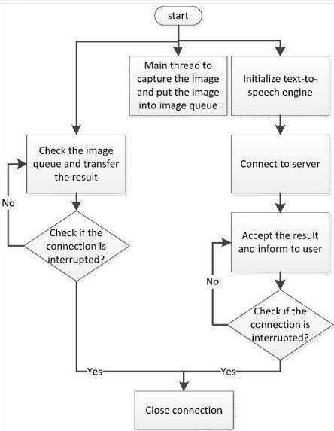
System Design - DFD

Slide 14
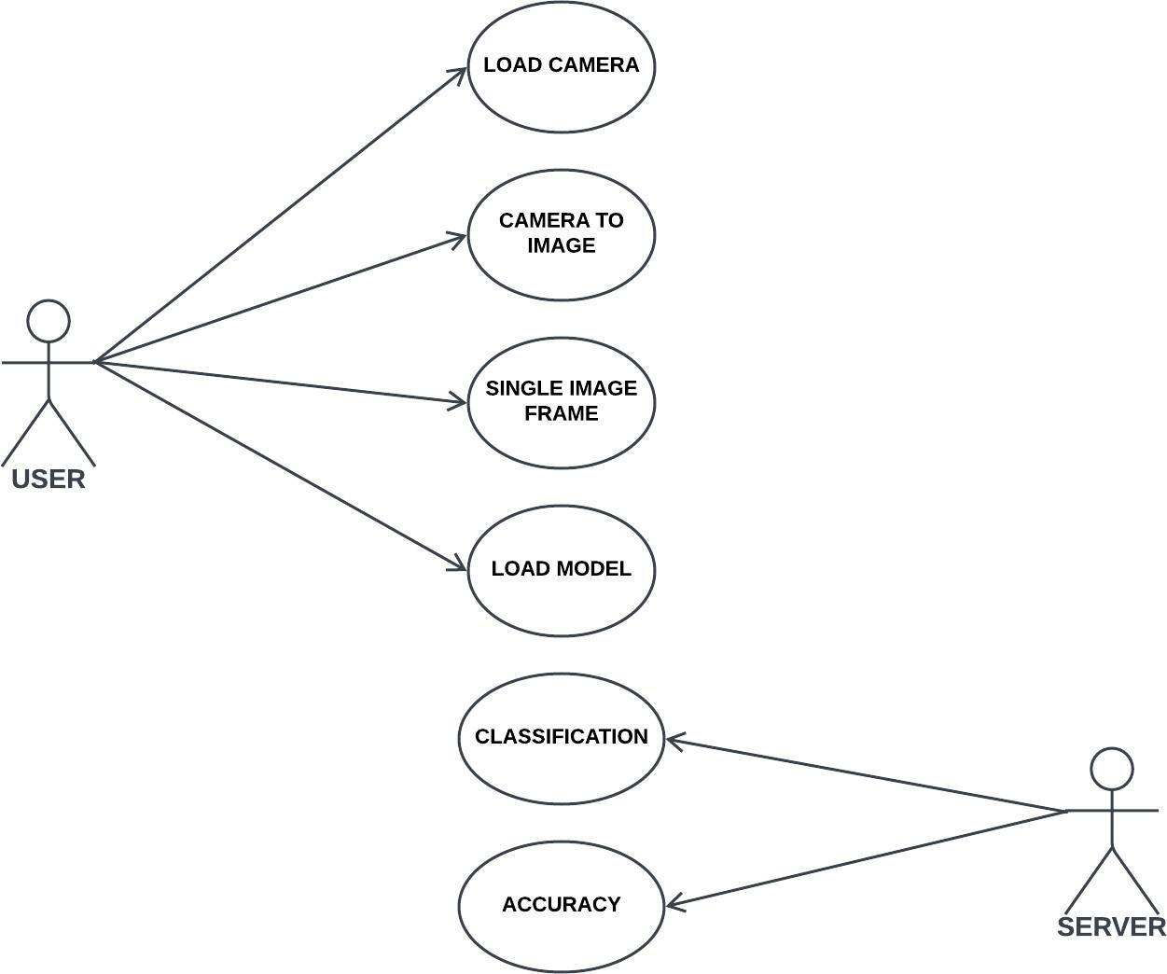
System Design - USE CASE DIAGRAM

Slide 15
INPUT CAMERA
The input camera is uses an obstacle detection algorithm to analyze the input camera is identify obstacle within it. These algorithms use machine learning techniques like deep learning to recognize patterns and features in the obstacle. First we gather the camera to classify the obstacle detection. The camera are trained using the dnn_Detection model. The live camera is streaming the camera portal. The Collected data are clearly and neatly to find the exact accuracy to the solution. The streaming are categories on camera to image.

Slide 16
IMAGE PREPROCESSING
An image classification task determines the category of a given input image in the clear dataset. It is a basic task in high –level image understanding and can be divided into binary and multi classification tasks. An image is classified in the output layer following the requirements. Activation function of the output layer is the only difference between binary and multi classification tasks. An image classification task for visual image analysis easily identified and then necessary actions can be taken to prevent visual tracking is an high performance in natural image classification, including dnn_Detection model can be used in JPG/PNG image classification.

Slide 17
FEATURE EXTRACTION
In machine learning, pattern recognition, and image processing, feature extraction starts from an initial set of measured data and builds derived values (features) intended to be informative and non-redundant, facilitating the subsequent learning and generalization steps, and in some cases leading to better human interpretations. Feature extraction is related to dimensionality reduction. When the input data to an algorithm is too large to be processed and it is suspected to be redundant, then it can be transformed into a reduced set of features (also named a feature vector). Determining a subset of the initial features is called feature selection. The selected features are expected to contain the relevant information from the input data, so that the desired task can be performed by using this reduced representation instead of the complete initial data.

Slide 18
OBSTACLE DETECTION
Obstacle Detection is an very prominent feature in the image since obstacle in detected. The visual obstacle need to be found when its running. Since the obstacle is detected, edges can be used for the same. Canny edge detection is found to give very good results once the thresholds are tuned properly. Image can be filtered before edge detection to remove noise. Edge detection results in a cluster of number of lines. We need to extract the obstacle out of it. The Obstacle Detection can be detected something alarm detected automatic send message to User.

Slide 19
Testing /Performance Evaluation / Results
At first, we are capturing real time images from the rear camera of the mobile handset of blind people and a connection is established between camera and system in laptop and then those images are sent from the camera to laptop.
This connection is done by a laptop software which is installed in the laptop of the person. All the real time images which get captured by the rear camera are first transferred to the in laptop where they are processed for some further conclusions.
The system in laptop will test it using its APIs and SSD ALGORITHM and it detects the confidence accuracy of the image which it is testing. We reached 98% accuracy for certain classes like books, cups, remote.
After testing the images we are generating an output on the laptop based system and its prediction is being translated into voice with voice modules and sent to the blind person with the help of wireless audio support tools.

Slide 20
Results
Driving with too short of a safety distance between the vehicles is a common problem in road traffic, which often results in traffic accidents as a consequence. The number of vehicles is increasing day by day and because different road conditions, accidents can occur between vehicles, human as well as animals, so object detection is very important. The main goal of this project is to develop object detection for accident avoidance and improving the Road Safety with Use of Raspberry Pi. A user-friendly visualization approach of the detected images is provided in this paper. The main purpose of the system is to implement the real-time objects detection system on a Raspberry Pi to avoid accidents and improving road safety. In which the system performs reprocessing using the mean subtracted difference extension (MSDE) and then segmentation is performed. Classification is done using proposed advanced classifier. The system can classify objects such as animals, people, cars, etc. After the object is detected the system will notify the user to slow down the car via voice message. The result analysis shows that proposed system is more precise and consumes less time than existing CNN and YOLO object detection methods.

Slide 21
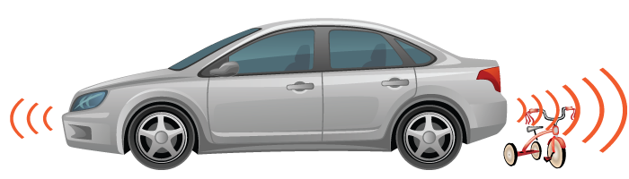
PROJECT USED IN:Car Cameras
The parking obstacle detection system warns a driver about nearby obstacles that are usually low to the ground (e.g., hydrant, bicycle, guard rail). It’s primarily for backing-up or for slow maneuvering when parking.According to the objects given in the database.If that an image is not there in database it stores for future reference and gives only alert message and will not specify what is the obstacle or object.

Slide 22
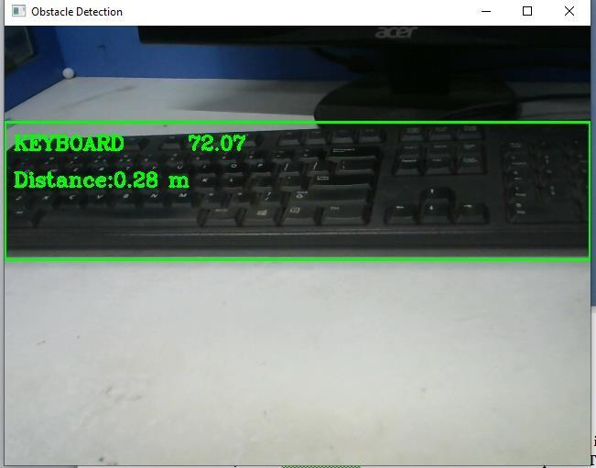
SAMPLE OUTPUT
Keyboard is detected.

Slide 23
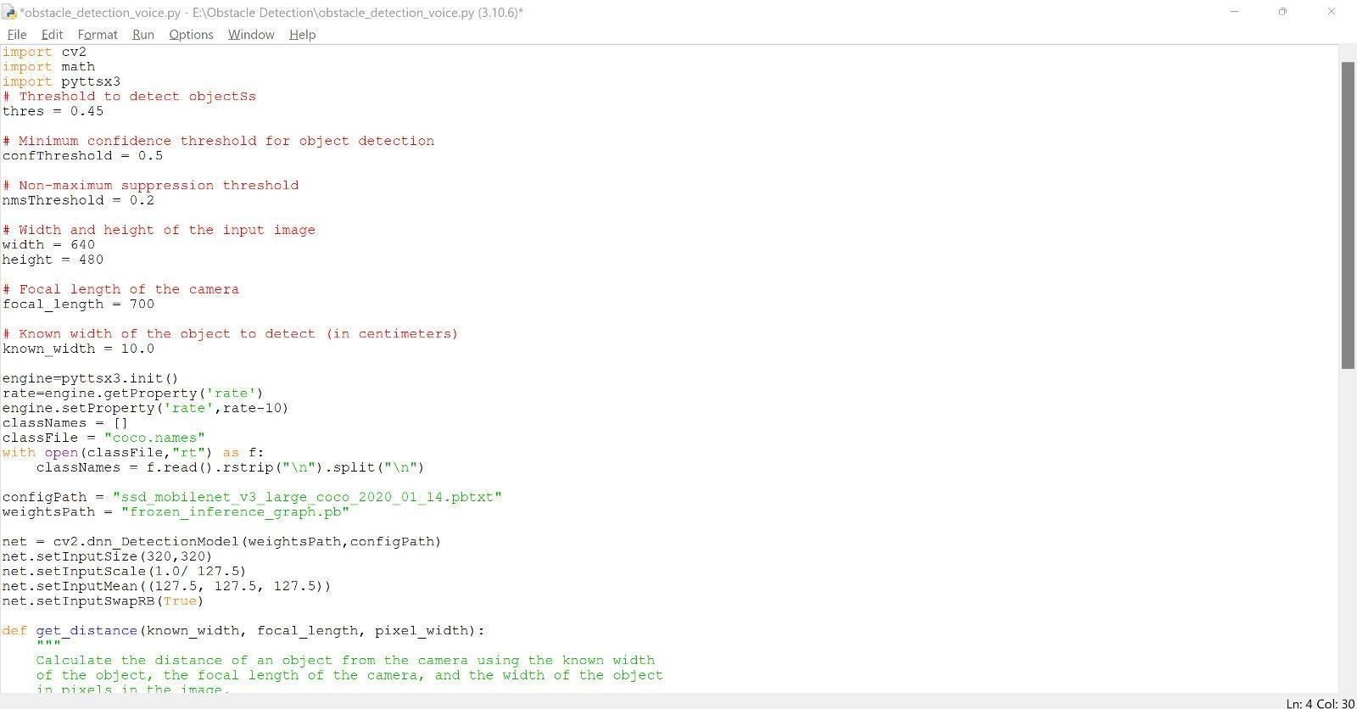
CODE
CODE IN THE SYSTEM

Slide 24
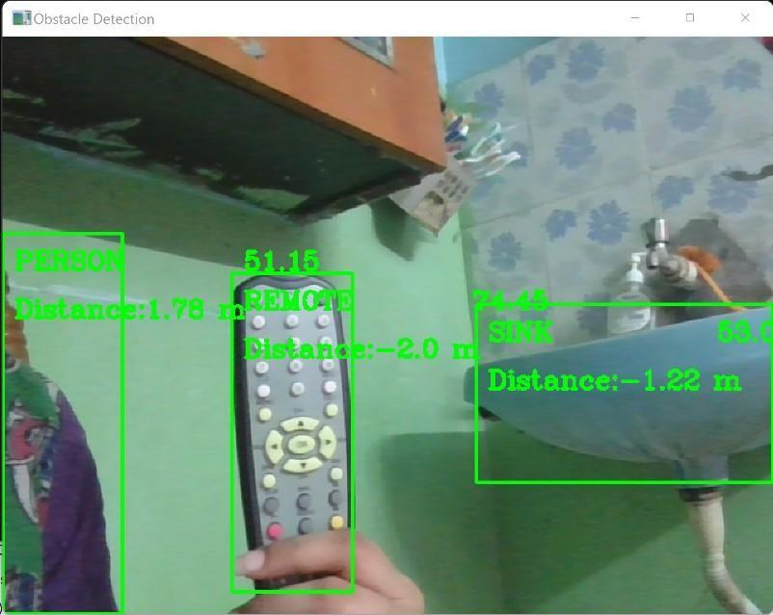
ACTUAL OUTPUT
Object (Person,Remote,Sink) is detected.

Slide 25
Conclusion / Feature Enhancement
Several technologies have been created find obstacles which will be helpful for visually impaired persons and self-driving cars(navigation). One such attempt is that we would wish to make an Integrated Machine Learning System that allows the blind victims to identify and classify real-time objects generating voice feedback and distance. Which also produces warnings whether they are very close or far away from the thing. For visually blind folks, this technology gives voice direction. This technique has been introduced specifically to assist blind individuals. The precision, on the other hand, can be improved. Furthermore, the current system is based on the Android operating system; it can be altered to work with any device that is convenient.
In future GPRS is installed for better outdoor navigation of the user.

Slide 26
Reference Paper/ URL
[1] Ye, T.; Wang, B.; Song, P.; Li, J. Railway Traffic Object Detection Using Differential Feature Fusion Convolution Neural Network.
IEEE Trans. Intell. Transp. Syst. 2020. [CrossRef]
[2] A. Ali and M. A. Ali, “Blind navigation system for visually impaired using windowing-based mean on Microsoft Kinect camera,” in 2017 Fourth International Conference on Advances in Biomedical Engineering (ICABME), pp. 1–4, Beirut, Lebanon, 2017
[3].https://link.springer.com/chapter/10.1007/978-3-030-58462-7_4#auth-Muhammad_Abdul-Haseeb
[4] S. Brahmbhatt, H. I. Christensen, and J. Hays, “Stuffnet: Using stuffto improve object detection,” in WACV, 2017.

Slide 27
Conference / Publication / Project Contest Winner Certificates

